Slide 1



Admin Training
Quality Management

Slide 2
Learning Objectives Quality Management
Teach
(Slides)
Show
(Demo)
Do
(Exercises)
Review
(Q&A)
Quality Management Overview
Quality Management Relationships
Workflow Approval / Spawning Follow-on Items

Slide 3

Quality Management Overview
With Quality Management workspaces, you can track and communicate non-conformances, initiate corrective / preventative action, and standardize your Return Merchandise Authorization process.
Nonconformance Management
Assess and classify failed items to quickly determine the type of corrective action necessary. Easily trace non-conforming items from problem discovery (inspection) to originator (supplier). Accurately estimate the cost of poor quality using item cost, quantity, and disposition accounting. React quickly by automatically opening corrective actions against legitimate non-conformances.
Corrective Actions / Preventative Actions (CAPA)
Formalize efficient quality improvement to reduce problem reoccurrences. Easily comprehend the problem, root cause and resolution on a single screen. Track investigations of probable cause and findings in a central searchable location.
Return Merchandise Authorization (RMA)
When a product needs repair or replaced within the product's warranty period, a repeatable RMA process is key to effective control. The RMA process and the issuance of an RMA is a key gatekeeping moment in the Reverse Logistics cycle, and commonly used in the high tech and consumer industries.

Slide 4
Quality Management in the App Store
These additional Quality Management workspaces are available through the App Store. With them you can collect and analyze quality data and define inspection standards.
Quality Inspection Plan
Capture the required inspection procedure for your products with the Quality Inspection Plan workspace. Users can quickly reference this instruction set while performing inspection to ensure that they are performed to standard.
Inspection Management
Define product performance tests and criteria and clearly report all examination findings. Easily tabulate inspection data traceable by item, type, supplier, or build designation. Detect trends early by analyzing the results of all prior inspection activities. Find the root cause of failed items faster by automatically by spawning a non-conformance.

Slide 5
Quality Management Overview
With Quality Management workspaces, you can collect and analyze quality data, define inspection standards, track and communicate non-conformances, initiate corrective action, and respond to issues.
Quality Inspection Plan
Capture the required inspection procedure for your products with the Quality Inspection Plan workspace. Users can quickly reference this instruction set while performing inspection to ensure that they are performed to standard.
Inspection Management
Define product performance tests and criteria and clearly report all examination findings. Easily tabulate inspection data traceable by item, type, supplier, or build designation. Detect trends early by analyzing the results of all prior inspection activities. Find the root cause of failed items faster by automatically by spawning a non-conformance.
Nonconformance Management
Assess and classify failed items to quickly determine the type of corrective action necessary. Easily trace non-conforming items from problem discovery (inspection) to originator (supplier). Accurately estimate the cost of poor quality using item cost, quantity, and disposition accounting. React quickly by automatically opening corrective actions against legitimate non-conformances.
Corrective Actions / Preventative Actions (CAPA)
Formalize efficient quality improvement to reduce problem reoccurrences. Easily comprehend the problem, root cause and resolution on a single screen. Track investigations of probable cause and findings in a central searchable location

Slide 6
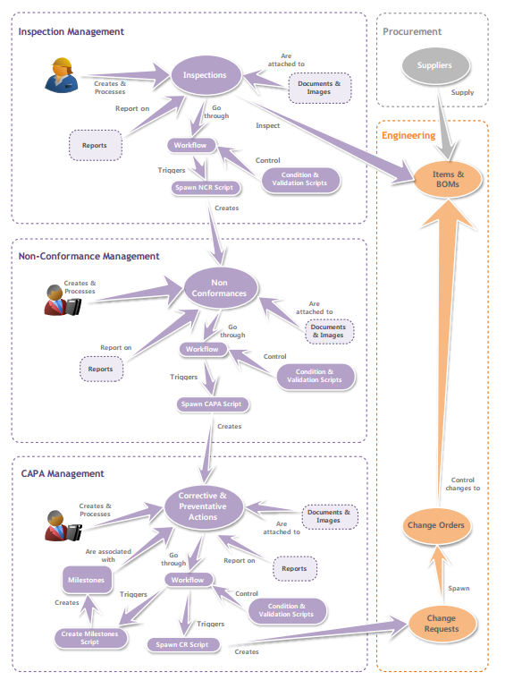
Quality Management Relationships

Slide 7
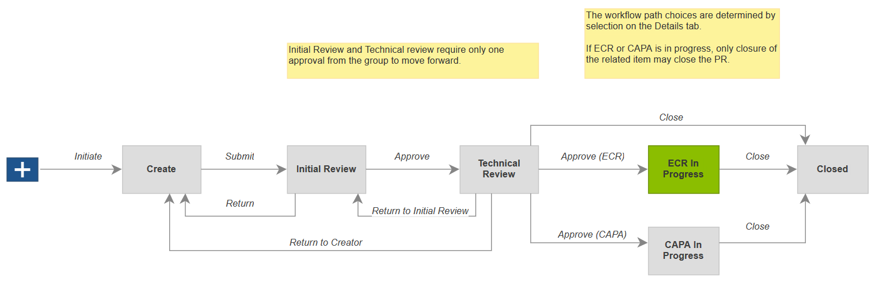
Problem Report Spawning Follow-on Items
Problem Report can generate and link a CAPA or Change Request
CAPA or ECR completion automatically moves Problem Report to Closed

Slide 8
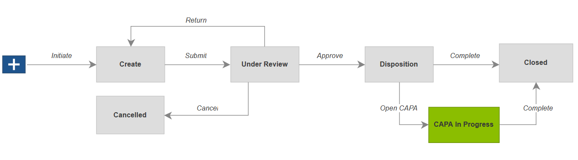
Non Conformance Spawning Follow-on Items
Non Conformance can generate and link a CAPA
CAPA completion automatically moves Non Conformance to Closed

Slide 9
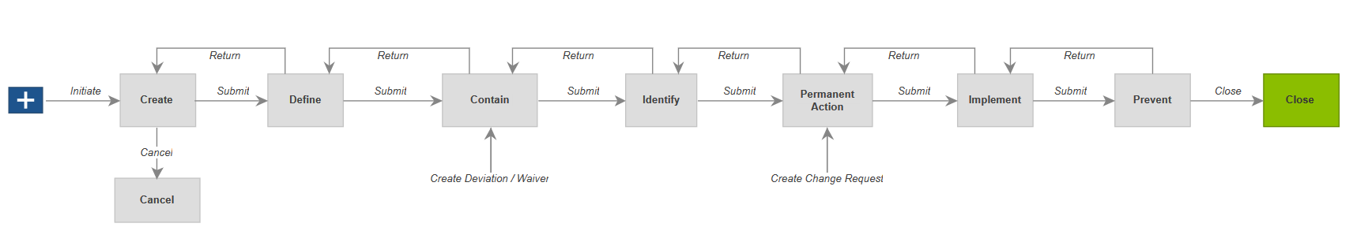
CAPA Spawning Follow-on Items
CAPA can generate and link a Deviation / Waiver and/or a Change Request
CAPA workflow continues independently of the Deviation / Waiver and/or Change Request

Slide 10

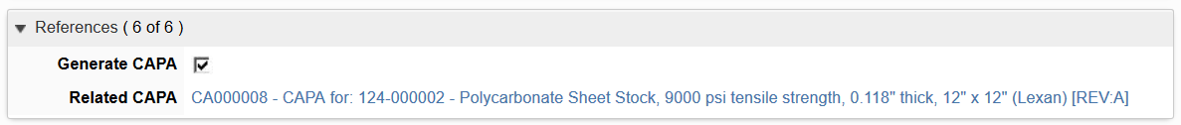
Workflow Approval / Spawning Follow-on Items
If “Generate CAPA” is checked, only allows path to Open CAPA
CAPA is automatically generated from Non Conformance
CAPA completion automatically moves Non Conformance to Closed

Slide 11
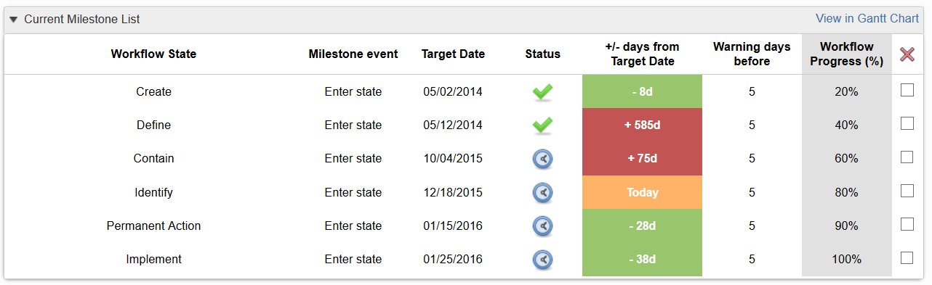
Teach
(Slides)
Show
(Demo)
Do
(Exercises)
Review
(Q&A)
Demo Topics Quality Management
Non Conformance
Workspace
Workflow
Generate CAPA
Corrective / Preventative Actions
Link from Non Conformance
Workspace
Milestones
Workflow
Generate Deviation / Waiver
Generate Change Request
Notes:
We will just introduce Milestones here and go into them in more depth in the Project Execution and Tracking portion, up next.

Slide 12
Exercises 1 - 2
Teach
(Slides)
Show
(Demo)
Do
(Exercises)
Review
(Q&A)

Slide 13
Review Quality Management
Teach
(Slides)
Show
(Demo)
Do
(Exercises)
Review
(Q&A)
Quality Management Overview
Quality Management Relationships
Workflow Approval / Spawning Follow-on Items

